Slide 1

the gym
1

Slide 2
The website layout and its different interfaces according to who is logging in :
Admin POV
Client POV
visitor POV
2

Slide 3
the end goals of our website
+ to attract new memebers
+ to provide current members with informations
+ to promote special events and promotions
+to build a better community
3

Slide 4
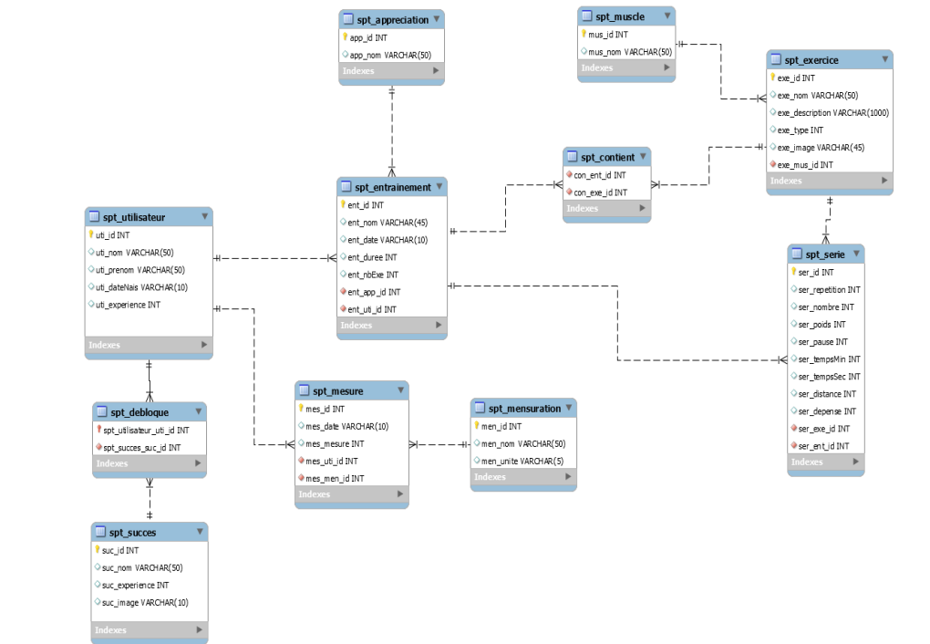
Diagramme de classe :

Slide 5
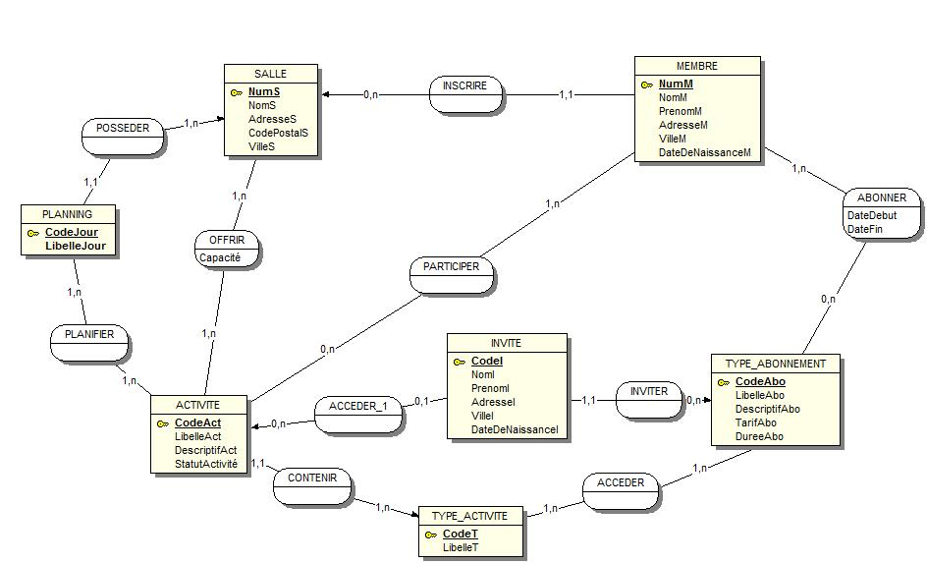
Diagramme de cas d’utlisation:

Slide 6
merci

